Slide 1
Understanding Blockchain Implementation Concepts in JAVA
Project: Creating a Blockchain with hashing DIFFICULTY level 5 and implementing a Proof of Work (mining) system with single miner
- Siddharth Gargava

Slide 2



Blockchain Technology Aim-
The aim behind using Blockchain technology is to get rid of centralized systems (like Government and Banks) that govern and monitor are transactions and instead use decentralized ones.
This Blockchain Implementation can get rid of these Third Parties
Product
Seller
Buyer

Slide 3

Understanding Blockchain in JAVA-
In JAVA terms, Blockchain is a linked list where the nodes are the blocks in the blockchain and the references are hashes of the previous block in the chain known as Cryptographic Hash.
Therefore, it is a continuously growing list of records (Blocks) which are linked and secured using Cryptography.
It is a trustless system without any third party as the blockchain itself guarantees trust.

Slide 4
Components of the Project (JAVA files)
vi) App
i) Constants
ii) SHA256 Generation
iii) Block
iv) Blockchain
v) Miner

Slide 5




Constants JAVA file-
Stores Variables like DIFFICULTY, MINER_REWARD and GENESIS_PREV_HASH
Mining in Blockchain has an important Parameter called DIFFICULTY which is characterized by leading number of zeroes in the Hash value. The DIFFICULTY set for my Model is 5.
The aim of mining is to generate hashes but most of the hashes are not allowed due to ‘number of leading 0s’ constraint. (DIFFICULTY level)
The more number of leading zeros are there, the harder it is to find the given hash.
MINER_REWARD is the reward the miner will receive after mining the given hash valued block.
GENESIS_PREV_HASH will have 64-bit values as 0 as the Genesis Block is the first block in the blockchain and has no hash preceding it.
P(finding hash with 1 leading zero) =
$$\frac{hashes with 1 leading zero}{total number of hashes}$$
$$\frac{1663}{1664}$$
= 1/16 = 6.25%
P(finding hash with 2 leading zero) =
$$\frac{hashes with 2 leading zero}{total number of hashes}$$
$$\frac{1662}{1664}$$
= 1/256 = 0.39%

Slide 6
SHA256 Helper Generation JAVA file-
This algorithm is used to generate hash values. || Input: The block itself || Output: hexa-decimal SHA256 representation
THE SHA256 Hashes are the fingerprints of the blocks
One hash takes up 256 bits in the memory with binary values (0 or 1); it means the total number of hashes is 2²⁵⁶ or 16⁶⁴ in hexadecimal character format
FFFFFFFFFFFFFFFFFFFFFFFFFFFFFFFFFFFFFFFFFFFFFFFFFFFFFFFFFFFFFFFF
FFFFFFFFFFFFFFFFFFFFFFFFFFFFFFFFFFFFFFFFFFFFFFFFFFFFFFFFFFFFFFFE
FFFFFFFFFFFFFFFFFFFFFFFFFFFFFFFFFFFFFFFFFFFFFFFFFFFFFFFFFFFFFFFD
.
.
.
2000000000000000000000000000000000000000000000000000000000000000
1000000000000000000000000000000000000000000000000000000000000000
0000000000000000000000000000000000000000000000000000000000000000
FEATURES OF SHA256 ALGORITHM-
Deterministic: It means that if we apply to same hash-function (SHA256) on the exact same input then the output must be the same.
One-way: It is easy to generate the hash with the given hashing algorithm but on the other hand it is extremely hard (time-consuming) to restore the original input
Collision-free: It means that no two different inputs share the same output hash
Avalanche effect: A little change in the input results in a completely different output hash

Slide 7
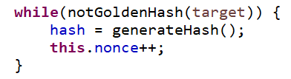
Block JAVA file-
Block is the fundamental unit of Blockchain.
Block has different variables given in the figure which determine the hash value.
Miner is going to increment the Nonce value to get new hashes for given block until he arrives at the golden hash (successfully achieving DIFFICULTY level) to be added to Blockchain.
block id
transaction(s)
hash
...
...
previous hash
nonce
timestamp
GIVEN BLOCK IN THE BLOCKCHAIN

Slide 8
Blockchain JAVA file-
GENESIS
BLOCK
BLOCK #1
BLOCK #2
BLOCK #3
...
Data: ...
Prev. Hash: 0000
Hash: 056FH
Data: ...
Prev. Hash: 056FH
Hash: HJI66
Data: ...
Prev. Hash: HJI66
Hash: ZU77F
Data: ...
Prev. Hash: ZU77F
Hash: 789BV
Blocks are stored in an Array List in Java and therefore new array list is instantiated.
Each Golden-hashed block is appended to the Blockchain.
No removal and modification of block is allowed once the block is appended to the Blockchain.

Slide 9
Miner JAVA file-
Mining is extremely important in Blockchain because the miners are validating the given blockchain transactions.
This Mining mechanism is about finding the right hash values for the blocks and adding them to Blockchain. This makes it a decentralized security system.
The MINER_REWARD in this Project is 10 units.
PROOF OF WORK IN MINING
If a miner finds the right hash he/she gets a reward but only if the other miners agree to accept that transaction (others can verify these easily with SHA256)
If a certain miner creates a fraudulent transaction, then all the other miners will refuse to accept it as a new block (so no point in creating a whole bunch of fraudulent blocks)

Slide 10
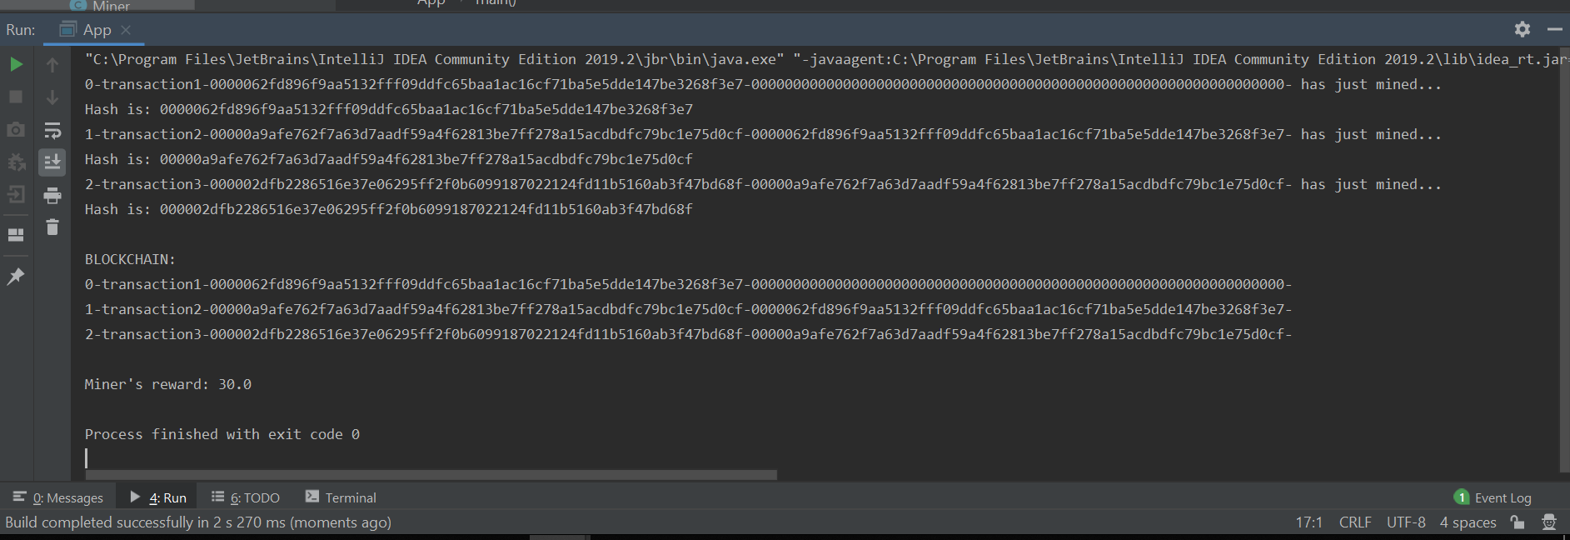
App JAVA file-
The App java file tests our blockchain implementation and outputs result-
A Blockchain is instantiated
A single miner increments Nonce value to mine Golden Hash block with DIFFICULTY of 5 leading zeros
This new block gets appended to blockchain
The Miner receives reward of 10 units for validation of block
OUTPUT

Slide 11
Conclusion-
This Project aims to create a Blockchain-
Made up of blocks that stores data
Has a unique digital signature(Hash value) that chains blocks together
Requires proof of work mining to validate new blocks
Can be checked to see if data in it is valid and unchanged

